Slide 1
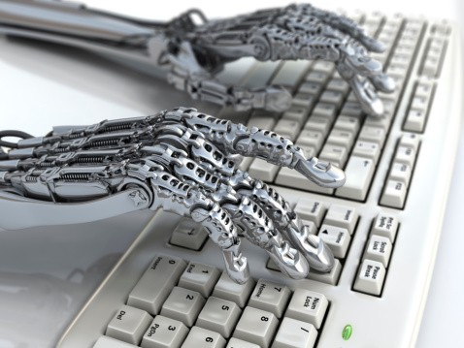
Automation and Reports Class 9
Oct 2018
Data 601, section 4

Slide 2
Guest Speaker: Patty Stanton
Data Scientist at Social Security Administration
Instructor for Data 604

Slide 3

Course schedule and outline (scope)
Oct 25: Automation, Reports
Nov 1: Scaling up, Estimation
Nov 8: Elasticity, Cost/benefit
Nov 15: Property graphs
Nov 22: No class (Thanksgiving)
Nov 29: Evaluation
Dec 6: Ethics and Legality
Dec 13: Presentations
Aug 30: Overview Data Science
Sept 6: Python in Jupyter
Sept 13: Math (stats)
Sept 20: Regression
Sept 27: Clustering
Oct 4: Getting data
Oct 11: Substitute's choice
Oct 18: Data cleanup

Slide 4
How to verify file consistency: check sums
https://en.wikipedia.org/wiki/MD5#MD5_hashes
https://en.wikipedia.org/wiki/Checksum
import hashlib
def md5(fname):
hash_md5 = hashlib.md5()
with open(fname, "rb") as f:
return hash_md5.hexdigest()
md5(filename)

Slide 5
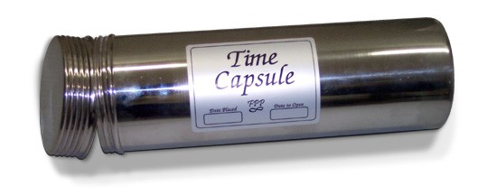
Activity: Review assumptions and expectations
What were your assumptions about this class?
What were your expectations?
Ben aggregates responses on the board

Slide 6

Log your assumptions and expectations
On a piece of paper or on your computer, record the date.
Write down your assumptions for the remaining classes
Write down your expectations for the remaining classes
Activity: think and write

Slide 7

Motivation: Why automate?
We can just hire more unpaid interns!
Notes:
https://alumni.berkeley.edu/california-magazine/just-in/2016-04-28/are-you-paid-less-tech-intern-cal-student-conducts-eye

Slide 8

Even interns consume resources
Unpaid Interns aren't free; as you scale up, they use
Floor space (work from home?)
Computers (I guess they could bring their own)
Direction/attention

Slide 9
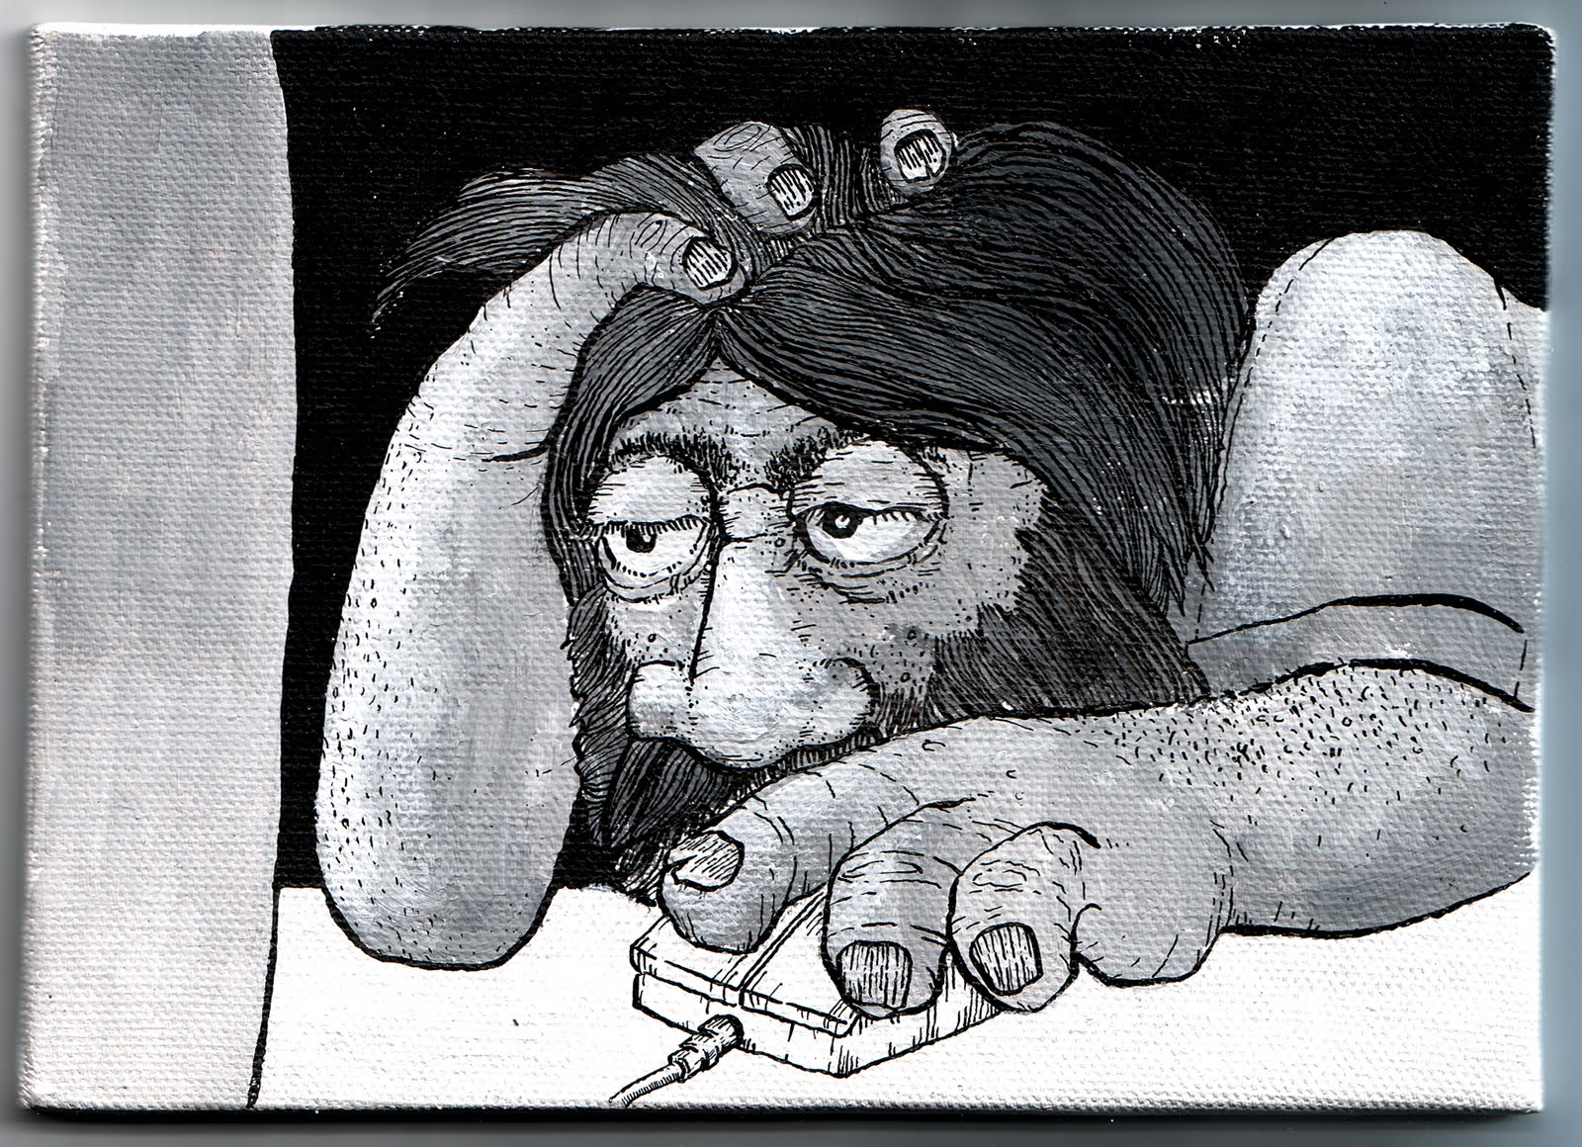
Or you can write the report yourself
Open Jupyter notebook
Run notebook code
Copy images, results from notebook
Open Microsoft Word
Paste images and results into Word
Save Word document as PDF
Email PDF to customer
Repeat on daily/weekly/monthly/quarterly/annual basis
Notes:
http://matpringle.blogspot.com/2010/05/office-drudgery.html

Slide 10
Outcomes for this evening
By the end of today's class, you should be able to do the following:
Generate HTML webpages using scripts
Generate PDF documents using scripts
Generate interactive websites using scripts
Send emails and text messages using scripts

Slide 11

Outline for this evening
Context and history of automation
Whose tasks get automated
Which tasks get automated
Implementation Examples
Homework

Slide 12
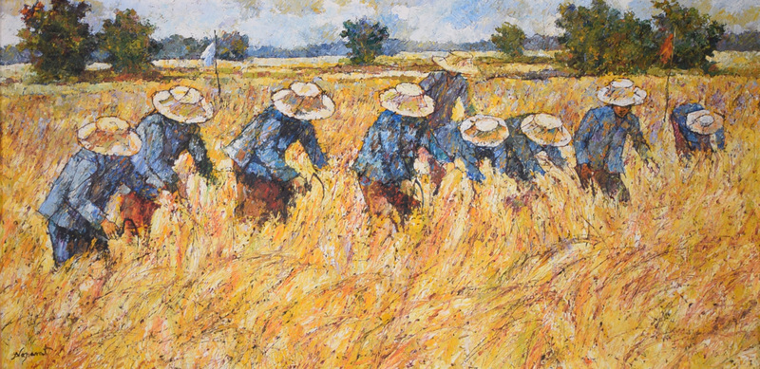
Why do we use machines?
To do things humans could do
and are repetitive
Noparat Livisddhi
source

Slide 13
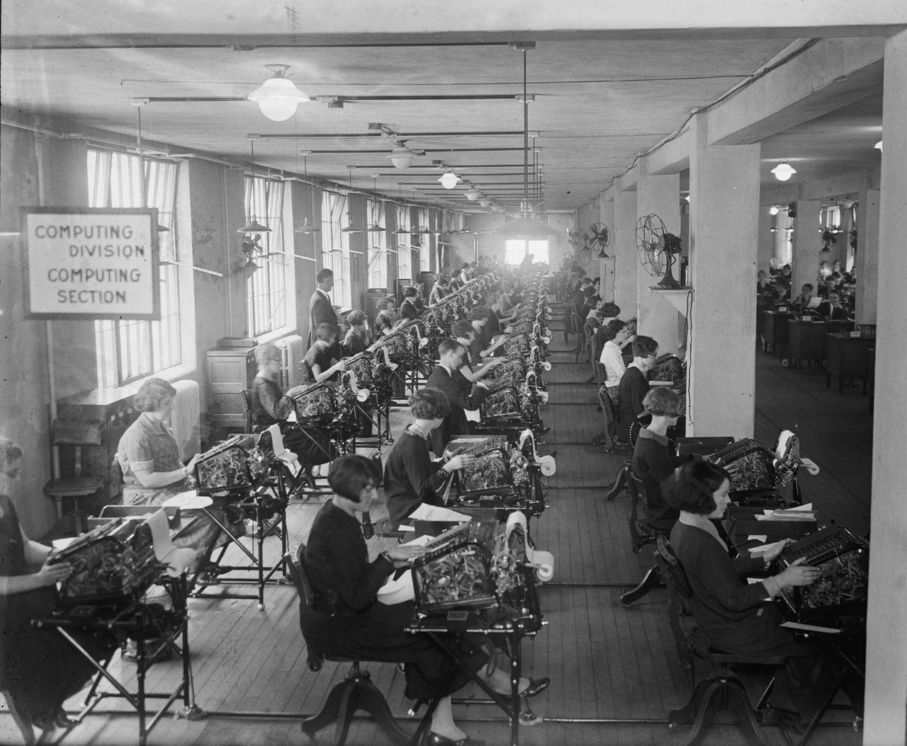
Why do we use computers?
To do things humans could do
and are repetitive
Decompose complex math
into lots of "simple" operations
https://en.wikipedia.org/wiki/Human_computer

Slide 14

https://en.wikipedia.org/wiki/West_Area_Computers
"All-African American all-female group of mathematicians" working 1943 through 1958.

Slide 15
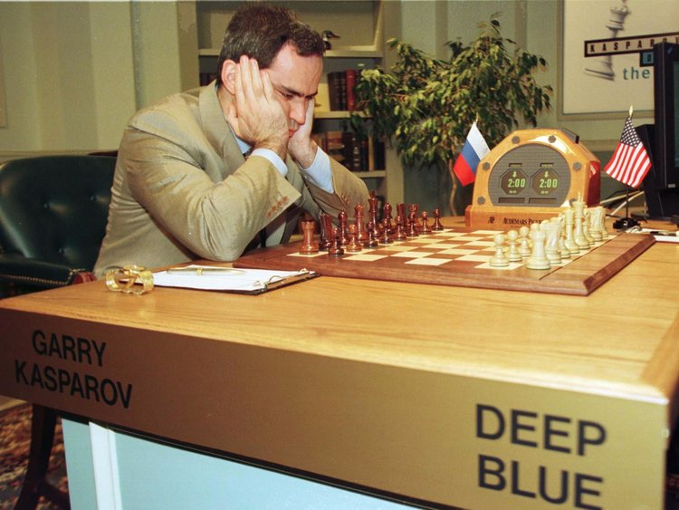
Consequences of automation
Computers can do things better than humans
"The 1997 match was the first defeat of a reigning world chess champion by a computer under tournament conditions."
https://en.wikipedia.org/wiki/Deep_Blue_versus_Garry_Kasparov

Slide 16
To read before class; discuss in class
Article on automation
https://www.theatlantic.com/technology/archive/2018/10/agents-of-automation/568795/?single_page=true
Comments on article:
https://news.ycombinator.com/item?id=18120322
Find a partner
Talk about the article
Activity: talk with a partner

Slide 17
Outline for this evening
Context and history of automation
Whose tasks get automated (in 3 parts)
Which tasks get automated
Implementation Examples
Homework

Slide 18

Are there tasks you do repeatedly? (1 of 3)
Sending email notifications
Getting data
Analyzing data
Reporting results

Slide 19

When automation is useful: Cold start as a data scientist
(2 of 3)
Cold start =
"cannot draw any inferences for users or items
about which it has not yet gathered
sufficient information."
https://en.wikipedia.org/wiki/Cold_start_(computing)

Slide 20
Being new can be challenging
(2 of 3)
Your first interaction with a stakeholder means there is no trust (yet)
Stakeholder may not know what value you can provide
How do you demonstrate skill?
By automating their tasks

Slide 21
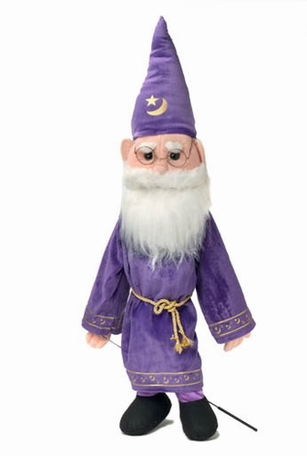

Two potential dangers of automation
(2 of 3)
People fear they could lose value as you demonstrate value
People learn to send you trivial tasks

Slide 22
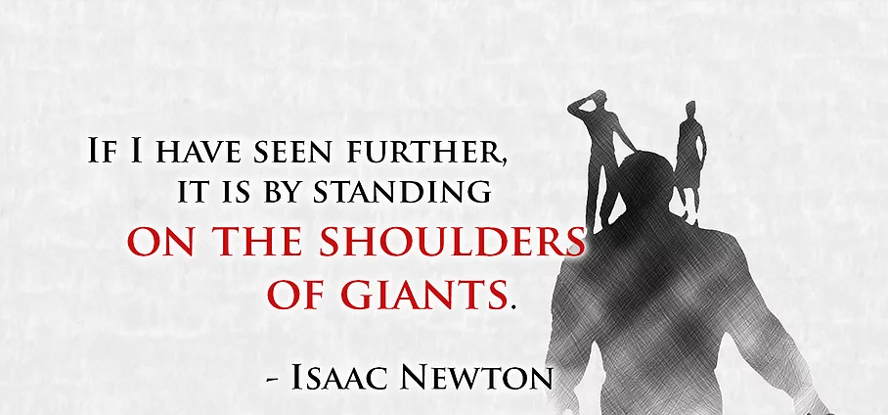
Automation is how you are able to progress
(3 of 3)
Source: https://www.wiltgren.com/game-design/where-does-influenced-by-become-stealing-a-design/

Slide 23
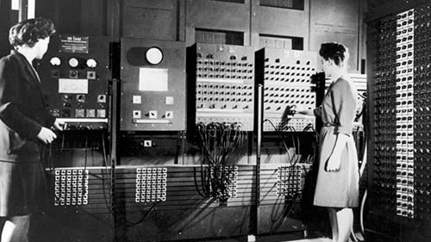
ENIAC programmers Frances Bilas (later Frances Spence) and Betty Jean Jennings (later Jean Bartik) stand at its main control panels. Both held degrees in mathematics. http://www.computerhistory.org/revolution/birth-of-the-computer/4/78
(3 of 3)

Slide 24
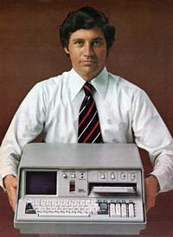
Modular hardware: Faster, cheaper, more reliable, fewer people
(3 of 3)
By abstracting details of hardware,
you get to focus on what matters to you
Purpose of abstraction layers is to make easier the things you don't want to have to care about.
The IBM 5100 is the first portable computer, which was released on September 1975. The computer weighed 55 pounds and had a five inch CRTdisplay, tape drive, 1.9 MHz PALM processor, and 64 KB of RAM.
In the picture is an ad of the IBM 5100 taken from a November 1975 issue of Scientific America.
https://www.computerhope.com/issues/ch000984.htm
Notes:
The intention of abstraction layers is to make easier the things you don't want to have to care about.

Slide 25
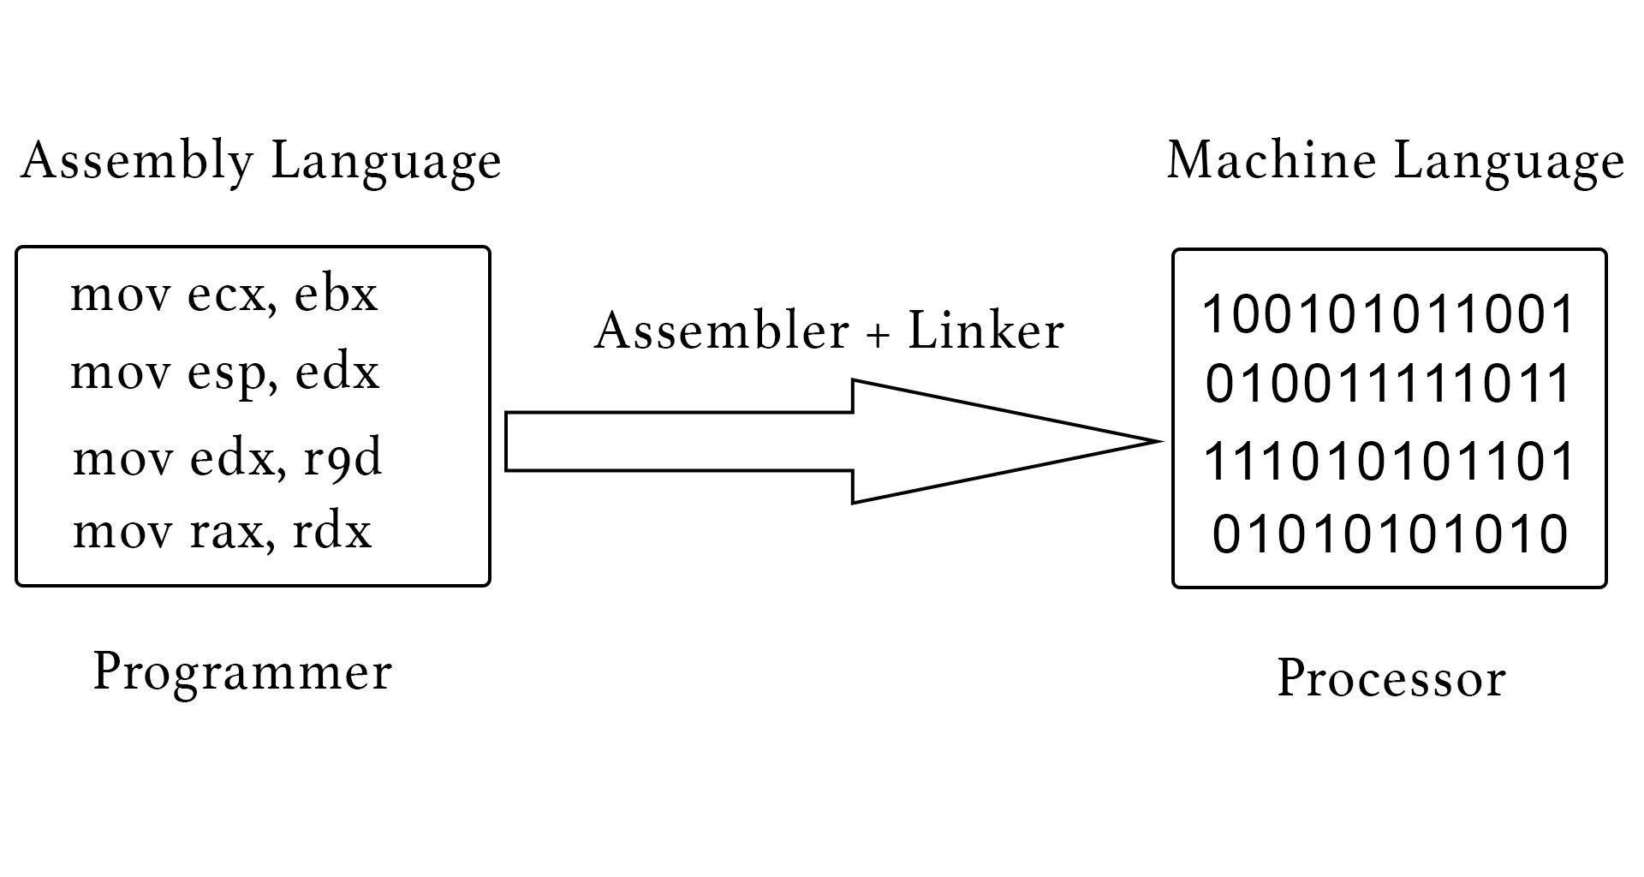
You benefit from (software) abstraction layers
(3 of 3)
Assembly means you don't have to write ones and zeros
C means you don't have to write assembly
Python means you don't have to worry about memory management (i.e. pointers and malloc)
Numpy means you don't have to implement linear algebra in Python
scikit-learn means you don't have to implement standard machine learning algorithms
TensorFlow means you don't have to learn CUDA

Slide 26
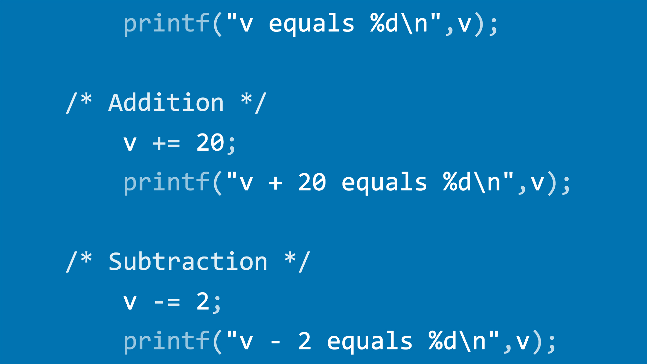
You benefit from (software) abstraction layers
(3 of 3)
Assembly means you don't have to write ones and zeros
C means you don't have to write assembly
Python means you don't have to worry about memory management (i.e. pointers and malloc)
Numpy means you don't have to implement linear algebra in Python
scikit-learn means you don't have to implement standard machine learning algorithms
TensorFlow means you don't have to learn CUDA

Slide 27
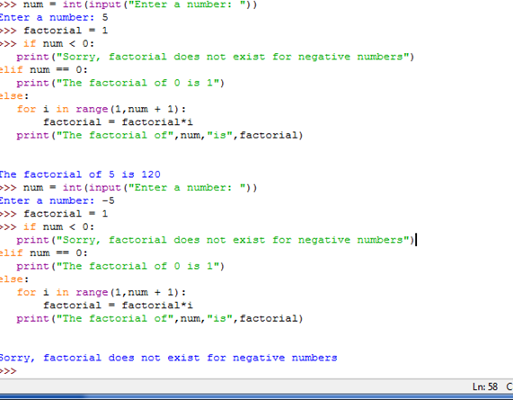
You benefit from (software) abstraction layers
(3 of 3)
Assembly means you don't have to write ones and zeros
C means you don't have to write assembly
Python means you don't have to worry about memory management (i.e. pointers and malloc)
Numpy means you don't have to implement linear algebra in Python
scikit-learn means you don't have to implement standard machine learning algorithms
TensorFlow means you don't have to learn CUDA

Slide 28
You benefit from (software) abstraction layers
(3 of 3)
Assembly means you don't have to write ones and zeros
C means you don't have to write assembly
Python means you don't have to worry about memory management (i.e. pointers and malloc)
Numpy means you don't have to implement linear algebra in Python
scikit-learn means you don't have to implement standard machine learning algorithms
TensorFlow means you don't have to learn CUDA

Slide 29
Automation: Identify recurring tasks and then automate the manual process
You, your tasks (save time, increase reliability)
Your stakeholders: this is how you add value before even starting data analysis
Data Science software frameworks (more generically, abstraction layers) get created
SAS, SPSS – GUIs for non-technical people to get stuff done
Spark, MapReduce, etc are for people who don't want to worry about complexity

Slide 30
Outline for this evening
Context and history of automation
Whose tasks get automated
Which tasks get automated
Implementation examples
Homework

Slide 31
What are the ways you exchange data with stakeholders*?
Brainstorming Activity:
Customers pay for a product
Users don't get a choice about the product
Stakeholders are affected by the product
Raise your hand if you have an idea
One contribution per person

Slide 32
Ways to exchange data with stakeholders
Verbal (in person, meetings, phone calls, video chat)
Email (ad hoc or scheduled), text messages
Presentations, i.e. Powerpoint
Data, i.e. Excel, in a directory
Analytics, i.e. programs written in Python (i.e. in Jupyter Notebooks)
Written documents , i.e. PDFs, DOCX (may also contain images and tables)
Web pages (may be interactive)

Slide 33
Ways to exchange data with stakeholders
If you only know how to manually use each of these channels, scalability of your impact is limited
Verbal (in person, meetings, phone calls, video chat)
Email (ad hoc or scheduled), text messages
Presentations, i.e. Powerpoint
Data, i.e. Excel
Analytics, i.e. programs written in Python (i.e. in Jupyter Notebooks)
Written documents , i.e. PDFs, DOCX (may also contain images and tables)
Web pages (may be interactive)

Slide 34
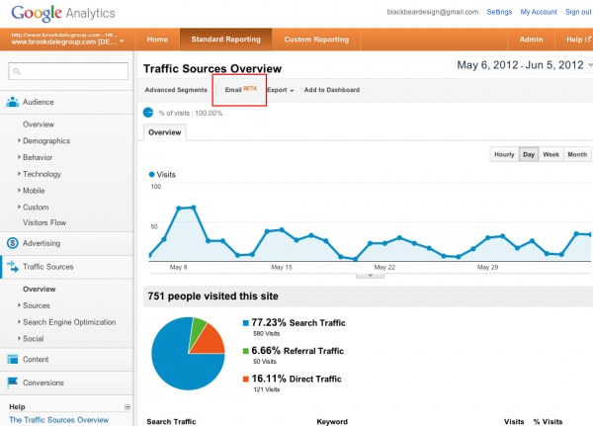
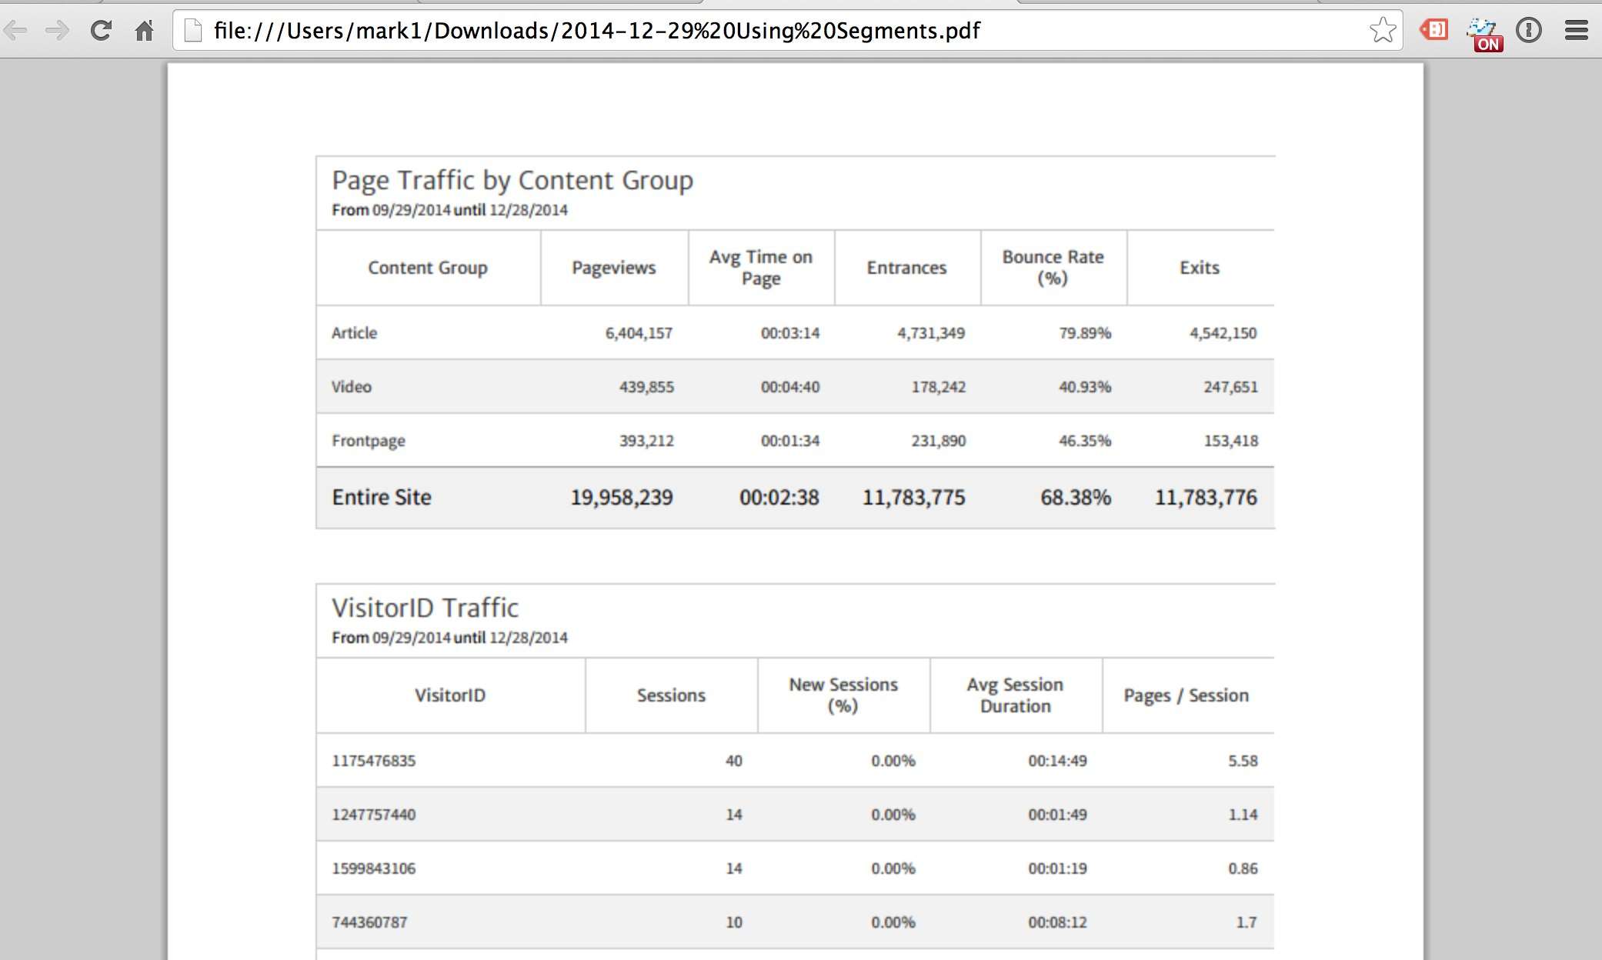
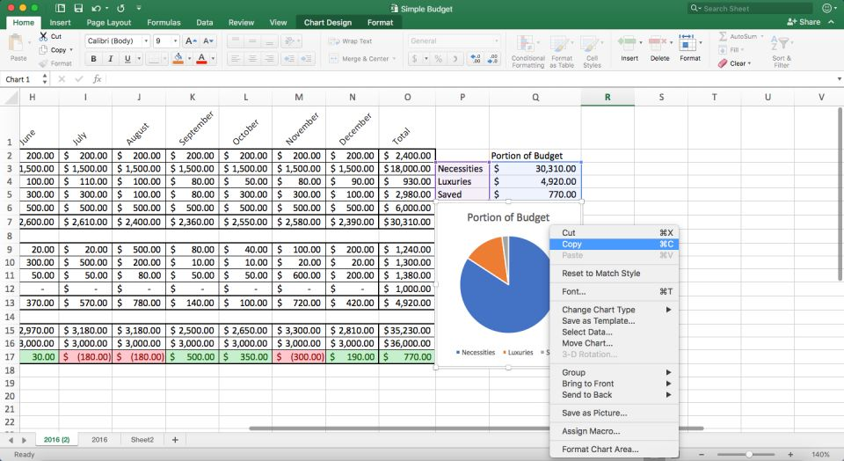
Data and Report are discrete
For electronic data exchange, I will consider
"streaming data" as batch updates

Slide 35
Just as Data Gathering is Automated, Automate Report Generation and Delivery
Scheduled (weekly/monthly/quarterly) reports
Ad hoc reports (i.e., when a threshold is reached)

Slide 36
Outline for this evening
Context and history of automation
Whose tasks get automated
Which tasks get automated
Implementation examples
Homework

Slide 37
Data is commonly in Excel
Pandas writes Excel files using the Xlwt module for xls files and the Openpyxl or XlsxWriter modules for xlsx files.
Source: https://xlsxwriter.readthedocs.io/working_with_pandas.html
Openpyxl can be used with Pandas for Excel for read/write
https://xlsxwriter.readthedocs.io/alternatives.html

Slide 38
HTML creation from Python
http://127.0.0.1:8888/notebooks/generate_HTML_using_jinja2/generate_HTML_using_jinja2.ipynb
https://en.wikipedia.org/wiki/Jinja_(template_engine)

Slide 39
PDF creation in Python
http://127.0.0.1:8888/notebooks/generate_PDF_from_HTML/HTML_to_PDF_using_xhtml2pdf.ipynb
Alternative:
https://weasyprint.readthedocs.io/en/stable/

Slide 40
Send email from Python
http://127.0.0.1:8888/tree/send_email

Slide 41
Send text messages via email
Use SMS gateway domain
Depends on service provider

Slide 42
Activity: ordering of activities
Count off by 5 (1, 2, 3, 4, 5, 1, 2, 3, 4, 5, 1, 2, 3, …)
Remember what number you are
Form a group of other people who have the same number
Each group of gets one set of "activities" that are part of your job as a data scientist
As a group, sort the activities into a prioritized list

Slide 43
Activity: ordering of activities
Count off by 5 (1, 2, 3, 4, 5, 1, 2, 3, 4, 5, 1, 2, 3, …)
Remember what number you are
Form a group of other people who have the same number
Each group of gets a set of "activities" that are part of your job as a data scientist
As a group, sort the activities into a prioritized list
As a group, describe to the class the first 6 activities you selected
Are there any activities than can be done concurrently?

Slide 44
Activity: ordering of activities
As a data scientist,
You will need to prioritize activities
You will need to negotiate priorities with other data scientists
You will need to justify your prioritization to stakeholders
Count off by 5 (1, 2, 3, 4, 5, 1, 2, 3, 4, 5, 1, 2, 3, …)
Remember what number you are
Form a group of other people who have the same number
Each group of gets a set of "activities" that are part of your job as a data scientist
As a group, sort the activities into a prioritized list
As a group, describe to the class the first 6 activities you selected
Are there any activities than can be done concurrently?

Slide 45
Groupby tutorial
https://www.kaggle.com/crawford/python-groupby-tutorial http://wesmckinney.com/blog/groupby-fu-improvements-in-grouping-and-aggregating-data-in-pandas/
http://127.0.0.1:8888/notebooks/python-groupby-tutorial.ipynb
Notes:
https://community.modeanalytics.com/python/tutorial/pandas-groupby-and-python-lambda-functions/

Slide 46
Interactive web pages: Flask for Python
~/Desktop/UMBC_data601_20181022/notebook/flask_demo/hello_world_static_page
$ FLASK_APP=my_flask.py flask run
http://127.0.0.1:5000/
~/Desktop/UMBC_data601_20181022/notebook/flask_demo/hello_name_page
$ FLASK_APP=my_flask.py flask run
http://127.0.0.1:5000/ben
~/Desktop/UMBC_data601_20181022/notebook/flask_demo/hello_html_name_page
$ FLASK_APP=my_flask.py flask run
http://127.0.0.1:5000/ben
Notes:
https://blog.miguelgrinberg.com/post/the-flask-mega-tutorial-part-ii-templates

Slide 47
Automating web actions with Selenium
Demo:
~/Desktop/UMBC_data601_20181022/scripts_for_week9/selenium_demo_imdb
Selenium is a last resort for data collection
Only use if wget, scrapy, curl don't work

Slide 48
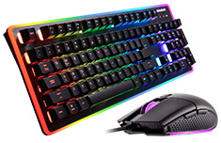
Automating mouse and keyboard input
AutoIt for Windows
Automator on Mac
{xdotool, cnee, actiona} for linux
Demo of Automator script
Notes:
https://askubuntu.com/questions/752325/any-macro-recorder-programs-availiable/1048943

Slide 49
How to figure out what to automate?
What's repetative?
What's taking a long time?
Record what you're doing, then analyze logs
https://en.wikipedia.org/wiki/Quantified_self

Slide 50
Outline for this evening
Context and history of automation
Whose tasks get automated
Which tasks get automated
Implementation examples
Homework

Slide 51
Mid-term project dates
(Oct 4): start proposal for mid-term
(Oct 11): Proposal for mid-term project due; submit via Blackboard
Oct 13-17: I grade the proposal and provide feedback on proposal
Oct 18: Start mid-term project
by Oct 27: participate in check-in with Ben, either via email or in person
Nov 1: Submit mid-term project for grading
Suggestion: check out the mid-term rubric posted to Blackboard

Slide 52
Mid-term report
A description of research methods can be called “coherent” and “complete” when readers understand the process well enough to replicate it themselves. [citation]
Analysis:
Applies methods learned in class
Uses Python 3 in Jupyter notebook
Demonstrates process of data science, from gathering data to telling story through characterization and prediction
Visualization: Intuitive, relevant

Slide 53
Reading assignment
The Art of Approximation in Science and Engineering
https://www.dropbox.com/s/bmqwzc8qqt5lv9p/9017.pdf
Read pages 20 to 36 of 409 (pages 1 to 17 in the PDF)
Comments:
https://news.ycombinator.com/item?id=18099596

Slide 54
Homework: use openpyxl
You get an Excel spreadsheet with two tabs
First tab ("main") has a "patient id" column that overlaps with "p_id" in the second tab ("another").
Use openpyxl to copy the patients from "another" to "main"
For patients on "another" that don't exist in "main," create new rows in "main"
Make no changes to the charts
Make no changes to the data on "another"
Write your changes to a new .xlsx file (don't overwrite the original)
Submit your .ipynb that makes the edits to the .xlsx file.

Slide 55
Tasks: research for scaling discussion
Each of you will receive a task that is due via email on Wednesday, Nov 1
What is the cost for storage?
What is the cost for compute?
What is the cost for data movement?
For {Amazon, Microsoft, Google, other providers}
Assume data origin/destination is Maryland, USA

Slide 56
Tasks: research for scaling discussion - storage
Each of you will receive a task that is due via email on Wednesday, Nov 1
What is the cost for storage? 1 TB/year; 100 TB/year
What is the cost for compute?
What is the cost for data movement?
For {Amazon, Microsoft, Google, other providers}
Assume data origin/destination is Maryland, USA

Slide 57
Tasks: research for scaling discussion - compute
Each of you will receive a task that is due via email on Wednesday, Nov 1
What is the cost for storage?
What is the cost for compute? 20 CPU cores w/ 1TB of RAM, 5 GPUs
What is the cost for data movement?
For {Amazon, Microsoft, Google, other providers}
Assume data origin/destination is Maryland, USA

Slide 58
Tasks: research for scaling discussion - move
Each of you will receive a task that is due via email on Wednesday, Nov 1
What is the cost for storage?
What is the cost for compute?
What is the cost for data movement? 10TB up, 10TB down
For {Amazon, Microsoft, Google, other providers}
Assume data origin/destination is Maryland, USA

Slide 59
Cloud {compute, storage} providers
Google
https://cloud.google.com/compute/
https://cloud.google.com/storage/
Amazon
https://aws.amazon.com/products/compute/
https://aws.amazon.com/products/storage/
Microsoft Azure
https://azure.microsoft.com/en-us/product-categories/compute/
https://azure.microsoft.com/en-us/services/storage/
Lots of smaller providers
https://www.digitalocean.com/
Lots of other services
Notes:
https://cloud.google.com/storage/pricing

Slide 60
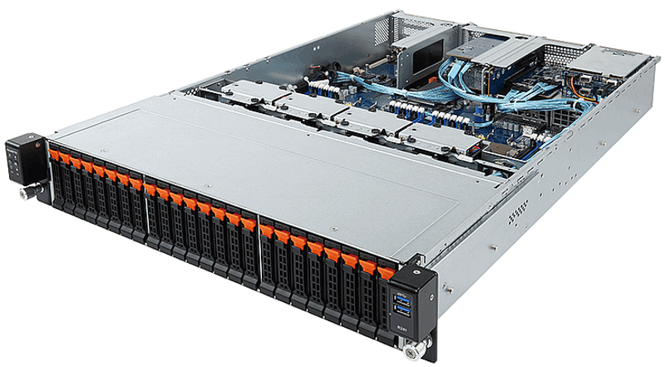
Self-hosted servers
20 cores, 1 TB of RAM, 10 TB of storage
Source: something like
https://www.newegg.com
Cost of acquisition
Power consumption would
be nice, not required

Slide 61

One thing you learned, One question you have
Notes:
https://www.uptoparents.org/blog/wp-content/uploads/2017/09/iStock-652179644.jpg

Slide 62
Design your approach to solving problem
On a piece of paper, write down actions you'll need to take
Determine the dependencies among the actions you need to take
In what order should the steps be?
If you have time before leaving, take the listed actions using your computer

Slide 63
Homework: use openpyxl
You get an Excel spreadsheet with two tabs
First tab ("main") has a "patient id" column that overlaps with "p_id" in the second tab ("another").
Use openpyxl to copy the patients from "another" to "main"
For patients on "another" that don't exist in "main," create new rows in "main"
"main" needs three new columns from "another"
There will be empty entries in "main"
Manually setting the columns is acceptable. Please use a programmatic approach to identify overlapping
Make no changes to the charts (the visualizations)
Make no changes to the data on "another"
Write your changes to a new .xlsx file (don't overwrite the original)
Submit your .ipynb that makes the edits to the .xlsx file.

